Slide 1
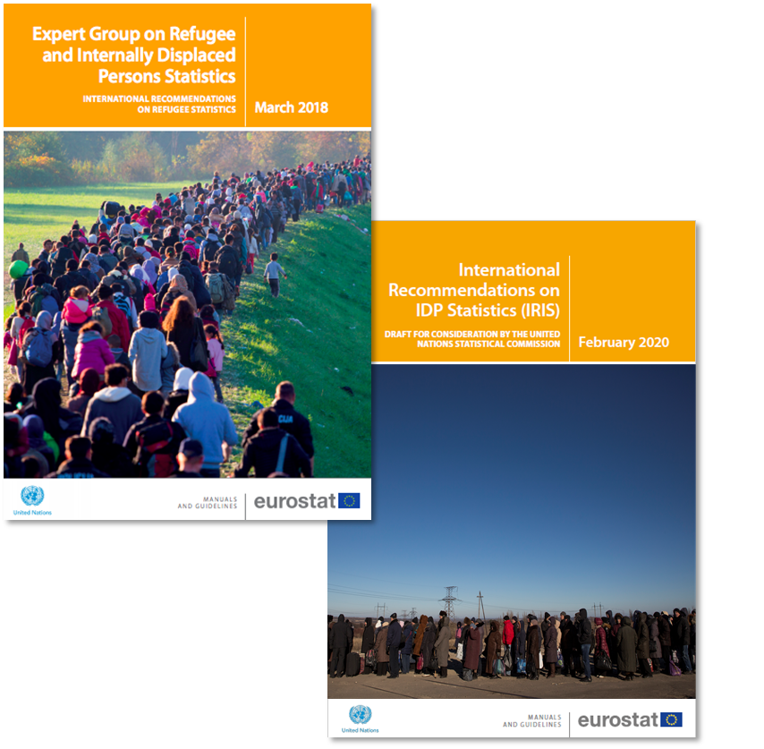

IMPROVING OFFICIAL STATISTICS ON FORCED DISPLACEMENT
UN World Data Forum 2021
Natalia Baal, EGRIS Coordinator
Notes:
Short presentation to highlight 3 things:
Why we needed international recommendations for refugees and IDPs?
Key achievements in this journey so far
Some highlights of the work we are currently engaged in
These remarks as a way to introduce/contextualise the presentations of subsequent speakers who will share more about implementation in their country contexts.

Slide 2
Why did we need an Expert Group on Refugee and IDP Statistics (EGRIS)?
Previously no statistical framework/standards or recommendations adequately addressing forced displacement
Most available data is operational data produced by humanitarian agencies, rather than official statistics
Significant data gaps and limited visibility, although opportunity in Agenda 2030’s pledge to ‘leave no one behind’
Strong and growing interest from countries to contribute to and benefit from clearer recommendations, including coherent definitions, enhanced national capacity and improved coordination

Slide 3
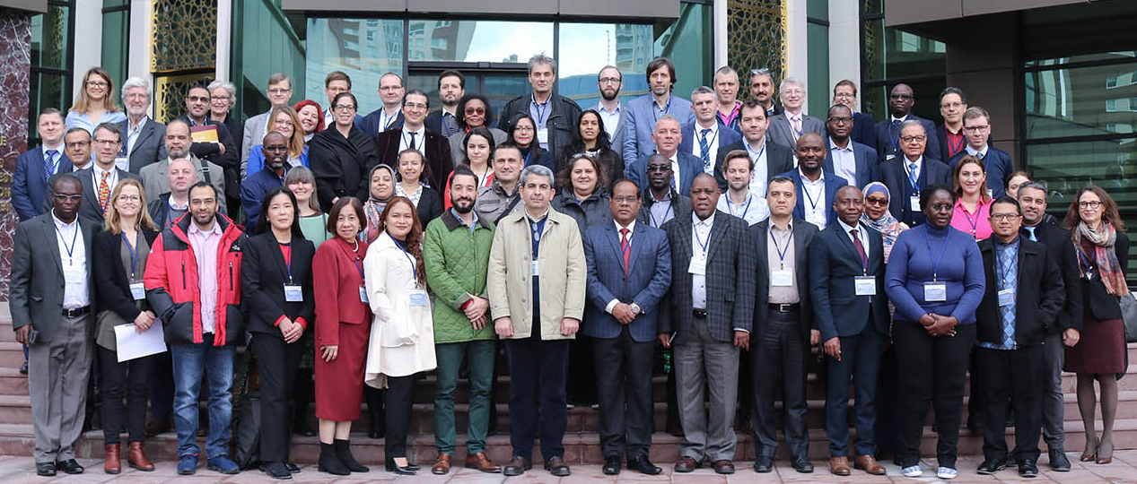
EGRIS – UNSC mandate & key achievements
Original mandate (March 2016):
International Recommendations on Refugee Statistics
Technical Report on Statistics of IDPs
Mandate extended (March 2018):
International Recommendations on IDP Statistics
Compilers’ Manual
Mandate extended (March 2020):
Implementation & capacity development
Methodological refinement
Enhance linkages to SDGs

Slide 4
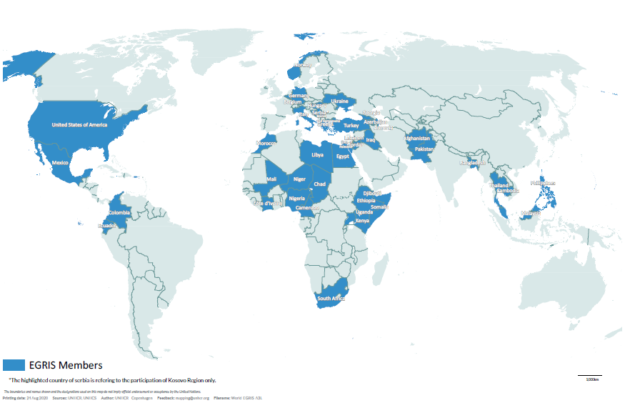
EGRIS Membership
45 Countries | 25 Regional and International Organizations
Steering Committee:
Colombia
Kurdistan
Norway
Ukraine
African Union (AU)
Eurostat
Internal Displacement Monitoring Centre (IDMC)
International Organization on Migration (IOM)
Joint IDP Profiling Service (JIPS)
UN Economic and Social Commission for West Asia (UNSCWA)
United Nations Refugee Agency (UNHCR)
United Nations Statistics Division (UNSD)
World Bank
WB-UNHCR Joint Data Center on Forced Displacement
Notes:
Participatory methodology – need for recommendations and other products to be relevant to the affected countries

Slide 5
What’s in the Recommendations on Refugee & IDP Statistics ?
Creation of a statistical framework standardizing relevant terminology and classifications
List of basic data tabulations and indicators
Assessment of data sources (admin data, census, and surveys) and methods and ways to improve them
Identification of socioeconomic indicators for refugee integration and wellbeing, and measurement of progress towards durable solutions for IDPs
List of recommended SDG indicators to be disaggregated by forced displacement
Steps to improve statistical coordination at national, regional, international levels

Slide 6
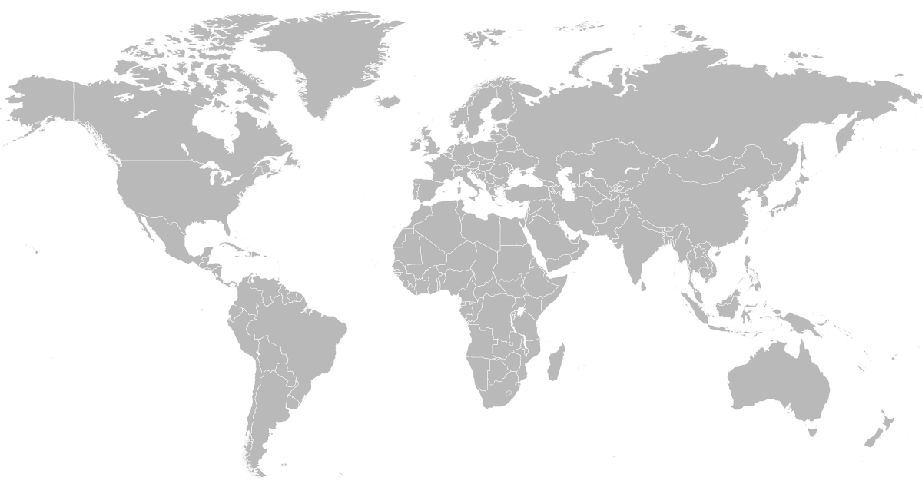
Disseminate & promote the Recommendations & Compilers’ Manual
Sub-group 1
What are we doing now?
Europe
Strong engagement from Norway, Germany, Italy, Ukraine, Georgia and Eurostat
Request TS from Ukraine
UNECE visibility
Strengthen statistical capacity & provide technical support
Sub-group 2
Capture lessons learned & Refining Recommendations and Manual
Sub-group 3
Asia and the Pacific
Refugees and stateless persons in Central Asia
International Conference on Official Statistics in Korea
Americas
Strong engagement from Colombia and Mexico
SICA workshop
Spanish translation of IRRS/ IRIS
International Recommendations on Statelessness Statistics
Africa
Strong engagement from Kenya, Uganda, Somalia, Cameroon, Cote D’Ivoire, South Africa and African Union
IGAD workshop series
Request TS from Somalia

Slide 7
Thank you
Natalia Krynsky Baal - baal@unhcr.org

