Slide 1



IRIS Implementation
Case Study: Ukraine
Olena Shevtsova
EGRIS SC Member,
State Statistics Service of Ukraine

Slide 2
Why is IRIS Implementation Important?
Enhances data-driven policies development
Supports IDPs integration and measurement
Facilitates durable solutions for IDPs
Fosters achievement of “ LNOB” principle enshrined in the 2030 Agenda
Promotes evidence-based decision making

Slide 3
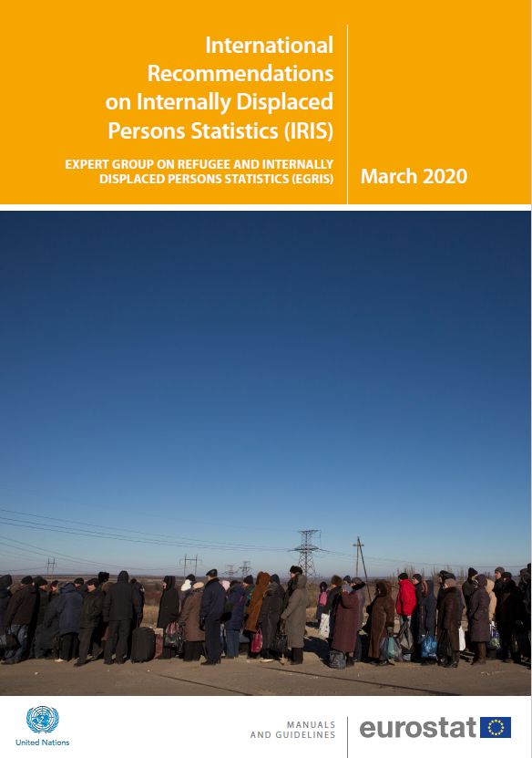
Scope of Work
Analytical product “IRIS and State of Play in Ukraine”. The objective of this document is to compare the IRIS and the existing statistical practices in relation to IDP statistics in Ukraine in order to formulate specific recommendations as to ways forward for development of the Roadmap for implementation of IRIS in Ukraine.
Roadmap for IRIS Implementation in Ukraine

Slide 4
Membership of IRIS WG in Ukraine
National Level
Global level
Non-Governmental Organizations – VoxUkraine, CEDOS
IOM, UNHCR, DRC-DDG, Council of Europe’s Project “Internal Displacement in Ukraine: Building Solutions”, Statistics Norway
International level
EGRIS
Governmental organizations: State Statistics Service of Ukraine, Ministry of Social Policy, Ministry for Reintegration, Secretariat of the Ukrainian Parliament Commissioner for Human Rights, Ministry for Development of Hromadas and Territories of Ukraine, National Social Services Service, State Migration Service of Ukraine, Pension Fund

Slide 5
Current Stage
Finalizing Analytical product that will encompass:
Definition of IDPs in IRIS and Ukrainian legislation
«Usual» and «habitual» place of residence in the context of internal displacement
Categories of IDPs (in the recommendations and Ukraine)
Long-term solutions and key vulnerabilities related to displacement (in recommendations and Ukraine)
Criteria for assessing IDPs integration
Data sources (in the recommendations and Ukraine)
Variables and tabulations
Coordination (in the recommendations and potential mechanism for Ukraine)

Slide 6



IRIS and Official Statistics for LNOB
Project: IDPs Integration Support Initiative in Ukraine
Main Objective of the Project: To strengthen the Ministry for Reintegration of Temporarily Occupied Territories of Ukraine (MRTOT) capacity to lead the evidence-based policy planning towards the integration of IDPs through comprehensive and participatory processes, including the design of indicators to measure IDP integration in Ukraine, based on the best national and international practices.
What has been done within the Project with regards to IRIS implementation in Ukraine?
Key result: IDPs local integration criteria and indicators, as well as implementation modalities for the state monitoring of the local integration of IDPs have been produced, discussed with the key stakeholders and outlined in the Concept Paper/Guidelines for the MRTOT.
Council of Europe Project Internal Displacement in Ukraine: Building Solutions
Overall objective: strengthening the capacities of internally displaced persons, displaced professionals, displaced institutions and other key stakeholders to improve the human rights protection of IDPs in Ukraine.
The project foresees component of extension of functional capacities of IDPs registry.

Slide 7
Lessons Learned
Engaging all stakeholders at the process of initiation
Setting a working group
Multi-level engagement is essential
Working-out algorithm of work providing synergy of efforts
Regular meetings for exchange of information
Strong coordination mechanism and mapping of activities
Advocating
Dividing work into phases, highlighting results during public events/ webinars
Strategic approach is important

Slide 8
Thank you for your attention!

