Slide 1
ANSWERING THE CALL: FORCIBLY DISPLACED DURING THE PANDEMIC
J Tanner, H Mugera, D Tabasso, M Lazić, B Gillsätter
JDC Paper Series on Forced Displacement, No. 2

Slide 2
Purpose of the second working paper:
Taking stock of emerging data and evidence on the socioeconomic experience of FDPs during the pandemic
Presenting interim data from high-frequency phone surveys
Connecting, where possible, the evidence from the high-frequency phone surveys to policy responses to the pandemic

Slide 3
Primary sources
Highly vulnerable yet largely invisible: Forcibly Displaced in the COVID-19-induced Recession
  T Vishwanath, A Alik-Lagrange, L Aghabarari
Compounding Misfortunes: Changes in Poverty since the onset of COVID-19 on Syrian Refugees and Host Communities in Jordan, the Kurdistan Region of Iraq and Lebanon
  World Bank – UNHCR. B Maleb, M Wai-Poi
Facing Double Crises: Jordan
  TA Kebede, SE Stave, M Kattaa
Facing Multiple Crises: Lebanon
  TA Kebede, SE Stave, M Kattaa
Bangladesh CBPS Phone Surveys
  N Krishnan, A Iffat Khan, H Esper
Chad HFPS
  A Savadogo, S Sawadogo, H Mugera, J Tanner
Djibouti HFPS
  B Malaeb, A Duplantier, R Jacky Gansy, S Tidani Konate, O Abdoulkader, J Tanner, H Mugera
Ethiopia HFPS
  C Wieser, N Dampha, A Ambel, A Haile Tsegay, H Mugera, J Tanner
Iraq HFPS
  K Krah, L Phadera, J Tanner, H Mugera
Kenya HFPS
  U Pape, J Baraibar, A Delius, T Beltramo
Uganda HFPS
  UNHCR: T Beltramo, I Sarr, P Waita; WORLD BANK: A Atamanov, N Yoshida, L Rios Rivera, K Yoshimura
Yemen HFPS
  S Tandon

Slide 4
Overview
Background: Domenico Tabasso
  Context of global displacement at the outset of the pandemic
  Conceptual and predictive models of how the pandemic might affect FDPs
The High Frequency Phone Surveys: Harriet Mugera
  HFPS methods
  6 dimensions of socioeconomic welfare
  Vaccine receptivity
  Heterogeneity
Discussant: Thomas Ginn

Slide 5
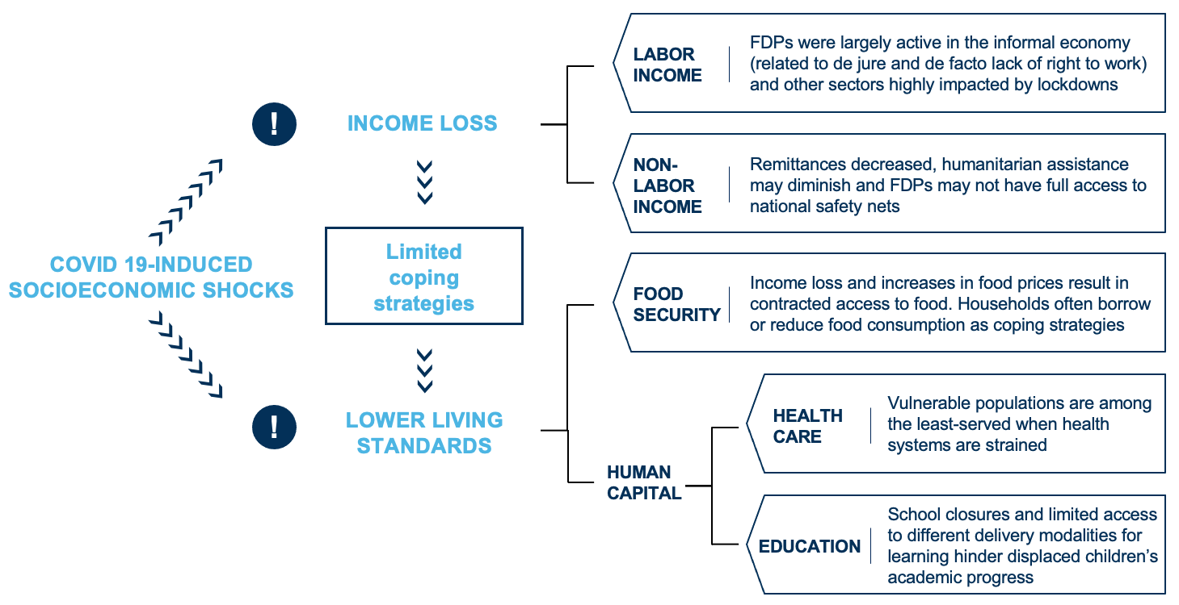
A conceptual model
Source: Vishwanath, Alik-Lagrange and Aghabarari; “Highly Vulnerable Yet Largely Invisible”

Slide 6
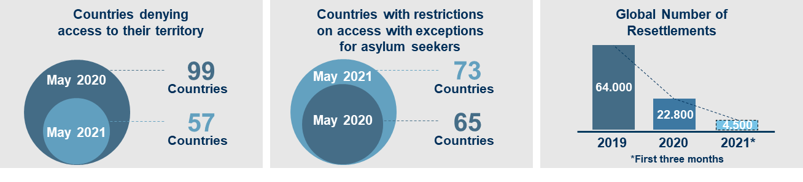
COVID-19 and restrictions on access around the world
Notes:
Now 45+75 26195

Slide 7
Background: FDP camps
Severe consequences given modes of transmission of disease
High population density
Limited access to health services
Limited access to general services
Considerable malnutrition
Notes:
Focus on more general backgrounds. May be useful in the blog to talk about some of these things. You have environmental effects which have effects on wellbeing. Pop Density is more of an independent variable while health access is the variable of interest.

Slide 8
Overview of early evidence
  Direct health consequences: lack of effect, or lack of evidence?
  But other effects are there: employment, poverty, food access etc.
  Low- and middle- income countries suffered extensively from the pandemic and might have to deal with more significant mid-term losses (IMF)
Notes:
Include from Domenico: Work that others have done where they’re doing predictive work. Take out graph. How did they collect the data?
3rd bullet is interesting. Check sources. Need to make it clear talking about predictive modelling or predictions in some sense but not actual data.

Slide 9
Employment
ILO estimates show heavy early impact on refugees in Jordan and Lebanon. Among the sampled individuals
  Jordan: 35% of employed Syrians lost their job permanently (17% among Jordanians)
  Lebanon: 60% of employed Syrians lost their job permanently (39% among Lebanese population)
CGD: Refugees 60 percent more likely than host populations to work in sectors highly likely to be impacted by the pandemic
Notes:
3,000 in Jordan 2000 in lebanon

Slide 10
Poverty
Estimated increase of population in poverty from Q1 2020 to Q4 2021; Syrian refugees and host communities in Lebanon and Kurdistan Region of Iraq.
COVID-19 has aggravated the socioeconomic conditions of both those forcibly displaced and their hosts
ILO estimated that the pandemic led to a 56 percent increase in poverty rates in low- and lower-middle-income countries for workers in the informal sector
Notes:
More fine

Slide 11
Policy Responses
Access to health facilities granted in several countries
At times embedded in broader measures (Chad, Colombia)
In other cases, targeting the COVID-19 emergency
Inter-agency collaboration, and partnership with national and local authorities crucial to deliver food to deprived communities

Slide 12
High Frequency Phone Surveys
Joint Data Center (JDC) in collaboration with World Bank and UNHCR teams, JDC identified six countries that either:
  integrate a representative sample of FDPs into the ongoing COVID19 high-frequency phone surveys that were being undertaken by the World Bank on the host populations to monitor welfare and behavioral changes during the pandemic
  execute a parallel survey on the forcibly displaced alongside those national surveys
Beyond the JDC,
  UNHCR worked directly with World Bank country teams in Kenya and Uganda to build out high frequency phone surveys on displaced populations (refugees and host populations)
  JDC supported the analysis for data collection that was ongoing in Yemen and Bangladesh

Slide 13
Countries and data of analysis
Country | Rounds | Population
Bangladesh ^ | 1 | Refugees: Cox's Bazar camps. Host: Cox's Bazar district residents
Chad | 1 | Refugees: in camps. Host: national
Djibouti | 1 | Refugees: camps and urban non camp. Host: national
Ethiopia | 2 | Refugees: camps and urban non camp. Host: national
Iraq * | 4 | IDPs, Returnees: KRI, North. Host: Nationals from KRI, North
Yemen*^ | 9 | IDPs: national. Host: non-IDP nationals
Kenya | 2 | Refugees: in camps. Host: national
Uganda | 2 | Refugees: in camps. Host: national
Countries with WB-UNHCR JDC support in bold
Countries with direct UNHCR/WB collaboration in italics
^ JDC support for data analysis
* Data collection in partnership with WFP.
Notes:
Additional from JDC
Burkina Faso
Jordan
Additional countries that we know about
Somalia (WB)
S Sudan? (WB)
Ecuador (WB)
Iraq – Refugees (UNHCR)
Morocco (UNHCR)

Slide 14
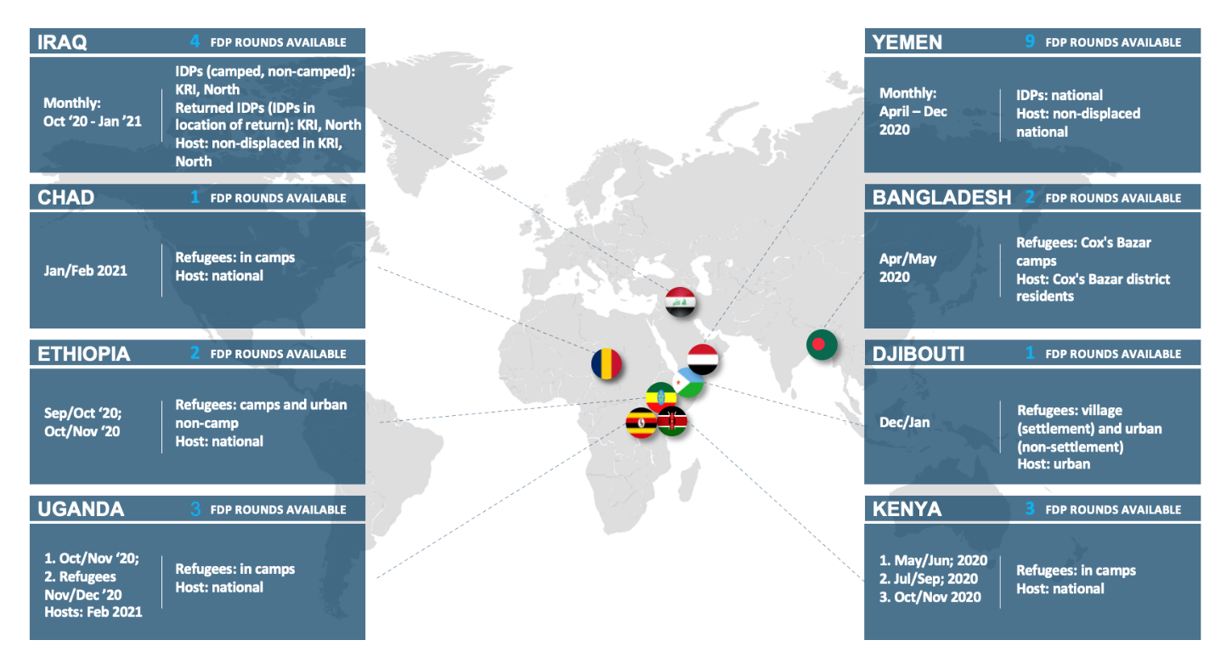

Slide 15
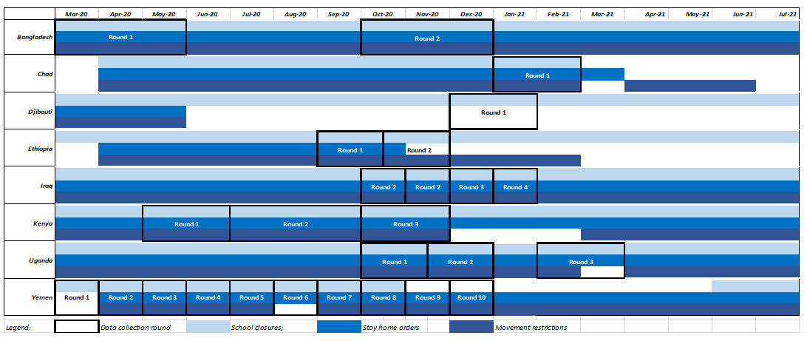
Timeline of the High Frequency Phone Surveys
Data collection rounds were not simultaneous or uniform across countries

Slide 16
What are High Frequency Phone Surveys?
Shorter survey (typically 30 minutes for each round)
Conducted repeated times (typically on the same sample)
Main survey instrument: mobile phone
Based on population with access to telephone and connectivity
Phone survey results must also be adjusted to overcome sampling and selection bias.
The results presented here are descriptive rather than causal.
Data have not been harmonized between countries > direct quantitative comparisons between countries’ statistics cannot be made.
Results presented here are both interim and preliminary in nature.
Notes:
The results presented allow us to identify patterns (or lack thereof) in the data
Samples robust and representtaive of these populations that have phones.
Viable complementary tool when face-to-face not possible
Demonstrated an ability to collect important timely data

Slide 17
Why High Frequency Phone Surveys?
  Provide a viable complementary tool when face-to-face interviews are not possible (during a pandemic/outbreak)
  Affordable and easy to implement
  Help target hard to reach populations (due to location or security issues)
  Can be used as a monitoring tool
  Enable collection of multiple components over timeas modules can be rolled in (and others out) over rounds
  Demonstrate an ability to collect important timely data
  Samples robust and representative of FDP populations that have phones
Notes:
Challenges:
Sampling bias -> only households (and household members with mobile phones)
Network coverage may be inconsistent in different contexts
HFPS: non-response rates may be high
Attrition over time may be high
Not in-depth interviews due to the instrument (phone) -> interviewer fatigue may come faster

Slide 18
Results from the HFPS: Labor Income (1)
Global Economic Slowdown
Evaporation of Labor Demand
Adverse effects on ability to work and earn an income for many households.
Displaced populations experienced employment losses, rate of which was often equivalent to or greater than losses experienced by host populations
Data indicate that refugees in the contexts analyzed are most often employed in sectors vulnerable to socioeconomic shocks (e.g. informal sector or as casual laborers)
As governments ease lockdown measures, signs of labor market recovery are often slow and heterogeneous across countries and within countries across time for both hosts and the displaced populations
Notes:
Make sure whatever is included in the Exec Sum is also included in the slides (at a minimum)

Slide 19
Labor income
Camp IDP, Non-Camp IDP and Host unemployment in Iraq
Employment outcomes were different for camped and non-camped FDPs
  Iraq: camp IDPs experienced significantly higher levels of unemployment than their non-camped counterparts
  Djibouti: In February 2021, 68 percent of urban refugees were working while only 49 percent of village refugees had the same status

Slide 20
Non-labor income
Households reporting income by source in Djibouti
Remittances and humanitarian assistance were most prominent sources of non-labor income
Displaced populations were often far more likely to rely on non-labor income than hosts
While some countries saw those sources decrease, reductions were more heterogeneous than anticipated

Slide 21
Non-labor income
Share of Returnees, Host, and IDP households that received public distribution system transfers in Iraq
Ethiopia: one-third refugee households received assistance between the outbreak of the pandemic in March and October 2020
Uganda: humanitarian assistance continued to be the main source of income for refugees
Chad: 59 percent of host households and 69 percent of refugee households experienced a decrease in transfers and assistance by early 2021

Slide 22
Living conditions: Health, food security, and education
COVID-19 induced shocks
Coping Mechanisms
Decline in Living Standards
Notes:
Quick observations: Drop slide 16. Instead have a slide on Human Capital that talks about health nutrition and nutrition.

Slide 23
Human capital
As a direct result of COVID-19-induced shocks, and as a result of coping mechanisms necessitated by income loss, living standards among FDPs are declined
By impeding access to food, education and healthcare, the pandemic may have long-lasting consequences on human capital formation
Even as lockdown measures and restrictions are lifted, and schools reopen access to the above necessities has yet to reach pre-pandemic levels

Slide 24
Healthcare access
The inability to access health care during the pandemic is a public health concern. As with so many dimensions of well-being, the pandemic has been disruptive to progress in health care access
FDPs’ lack of financial resources was reported as a consistent barrier to accessing medical treatment in Chad, Djibouti, Ethiopia
Mental health is a critical component of overall wellbeing. In Uganda: 54 percent of refugees reported depression—a level 10 times higher than for host households
Notes:
Include Mental health here too

Slide 25
Healthcare access
Share of respondents with poor access to health care in Yemen
The surveys showed that although trajectories of improving or deteriorating access to medical care differ from country to country, displaced households typically faced greater challenges than their hosts when looking to access medical care
In some instances (Uganda, Yemen) health access among FDPs follows a similar track to that of hosts

Slide 26
Food insecurity
Food Insecurity in Chad, January-February 2020
In times of economic stress, vulnerable groups may adopt coping strategies that result in reduced food security
Access to food and food security were prominent concerns for both FDP and host households, though it was generally worse for displaced households
Access to food heterogenous within FDP groups. In Djibouti, urban – based refugees are more likely to be food insecure than village-based refugees or urban hosts and children from households with a female breadwinner for both the urban host and the refugee samples

Slide 27
Food insecurity
The reasons for the observed food insecurity are varied, but for the countries surveyed, financial constraints are among the top two reasons given
Reduction in food consumption common coping mechanism deal pandemic related shocks

Slide 28
Access to education
School closures and household financial stress may inhibit and have long lasting consequences on children’s academic and learning progress
Looking ahead, the process of reopening schools may be slow and uneven.
  Ethiopia: fewer than one in ten refugee households with school-age children indicated that their child’s school was open one month after country officially reopened schools
Schooling showed signs of recovery in some of the countries surveyed.
  Uganda: after an initial dip, there was a substantial increase in the share of refugee households with members participating in education/learning activities

Slide 29
Access to education
Educational engagement for refugee households’ children in Ethiopia
For most countries, displaced children’s low school enrollment before the pandemic was followed by even lower educational engagement during the pandemic
Generally, “educational engagement” during pandemic included any form of education beyond attending in-person classes in a school, such as online engagement, completing assignments from teachers, or listening to educational programs on radio or television

Slide 30
Household Shocks Over the Pandemic
FDP households in the countries studied were particularly vulnerable to socioeconomic shocks as a result of the pandemic. For example
  In Uganda, every refugee household sampled suffered at least one socioeconomic shock during the pandemic. This was significantly lower for host population households, 42 percent of whom did not experience any shocks between March and June 2020
  In Chad, six out of ten refugee households experienced at least one negative shock since the onset of the pandemic
These shocks included decreases in income and employment, limitations in access to healthcare, education and food

Slide 31
Coping Mechanisms
In response to socioeconomic shocks, households engaged in a range of coping strategies, including
  soliciting assistance from family and friends
  seeking assistance from government and other organizations
  cutting expenditures including reducing food and non-food consumption
Forcibly displaced households across Bangladesh, Chad, Djibouti, Ethiopia, Iraq, Kenya, and Uganda reported reducing either food or non-food consumption or both
Notes:
Could say a little bit more.

Slide 32
COVID-19 awareness and behavior
Most households had a good knowledge of COVID-19 symptoms and preventive measures, even from fairly early in the pandemic
Practice did not always match knowledge as some household struggled to translate awareness into a change in behavior
Finally, the data suggest that there is likely to be demand for testing and vaccination among the forcibly displaced
Notes:
Develop a background slide that has the 5 countries with vaccine: bar graph.

Slide 33
Vaccine Receptivity
Notes:
Vaccine receptivity is generally high among displaced populations.

Slide 34
Heterogeneous effects
Effects of pandemic have not been homogenous across the 8 countries observed. For example;
  While employment trends differed for FDPs in Kenya are showing signs of recovery (increasing from 6% in May – June to 16% in Oct – Nov, the opposite is present in Uganda where employment went from 43% in Sept-Oct dropping to 36% employment in Oct-Nov ​
  Humanitarian assistance for FDPs increased in most countries, NGO assistance decreased for 52 percent of households in Chad
  FDPs, on average, experienced greater levels of food insecurity than hosts except in Ethiopia where refugee households’ ability to purchase food items if needed was higher compared to the national population
  Effects varia based on the location of FDPs (camp/settlements vs non camp)
Notes:
Differences:
Within country (across the different groups) -> and for each of the socioeconomic outcome we are analyzing
Differences when we look at the outcomes and the trends and compare the FDPs in different countries
Differences within the FDPs -> location (urban vs rural) or whether they live in camps/settlements or out of camps/settlements

Slide 35
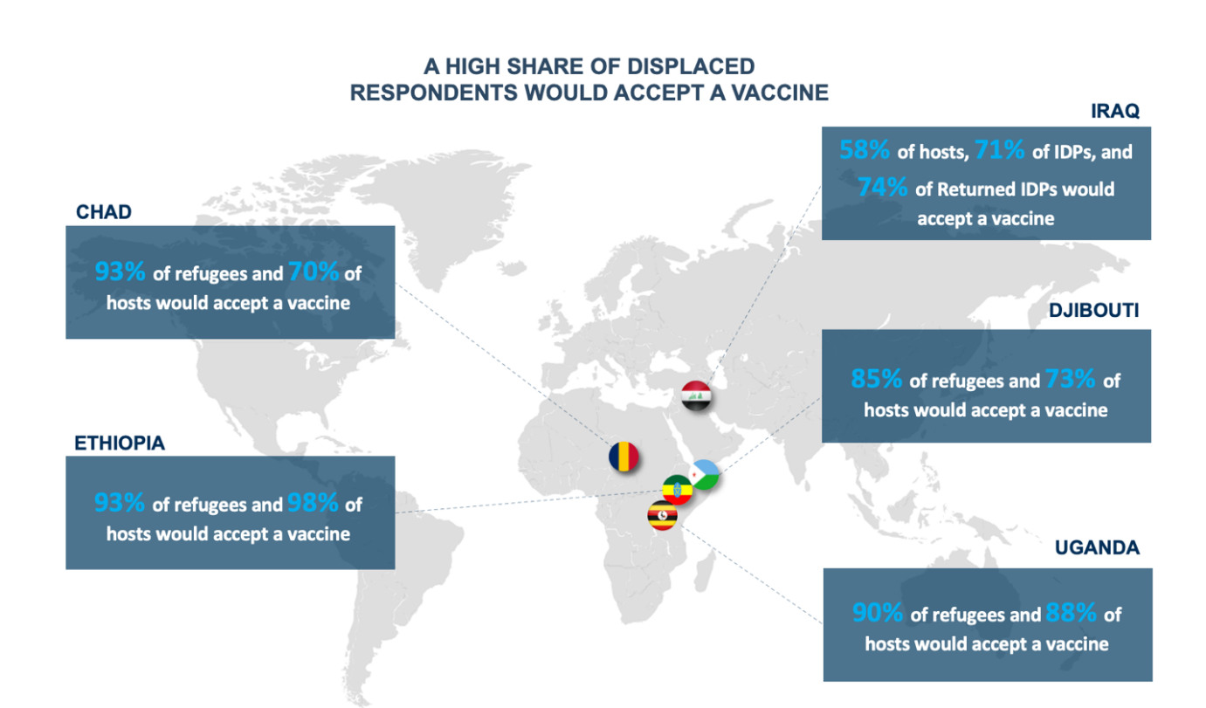
Vaccine receptivity is generally high among displaced populations.

Slide 36
Camped and non-camped
Effects of pandemic were not heterogeneous between camped and non-camped FDPs.
  On average, camped FDPs experienced lower levels of employment(Iraq, Djibouti, Ethiopia) and higher labor income loss(Djibouti) during the pandemic
  Camp FDPs in Iraq, Djibouti and Ethiopia relied more heavily on humanitarian assistance than their non-camp counterparts
  Camp refugees had better access to healthcare when needed and enjoyed more food security in Iraq and Djibouti while the same cannot be said for Kenya
  Education engagement and school enrollment was lower for children in Ethiopia and Kenya during the pandemic and post school lockdown

Slide 37
Observations from the data
The full socioeconomic impact of COVID-19 will play out over the medium- to long-term for developing countries
Need for robust tracking mechanisms that collect regular and reliable data on vulnerable groups is clear
High-frequency phone surveys are examples of a data collection mechanism that can produce much-needed data on how the forcibly displaced fare over time and space in various settings
Inclusion of FDPs in data collection of population statistics is vital

Slide 38
Further questions to consider
The degree to which initial economic and social conditions are associated with FDP and host outcomes and convergence
Exploration of the explanatory factors of the (few) examples of positive outcomes or faster recovery
The variation in policies implemented at the national level, and the extent to which FDPs were included or not
and how development and humanitarian actors filling existing operational and policy gaps and where have they successfully amplified the national response

Slide 39





Thank you!
Domenico Tabasso, tabasso@unhcr.org
Harriet Mugera, hmugera@worldbank.org

