Slide 1
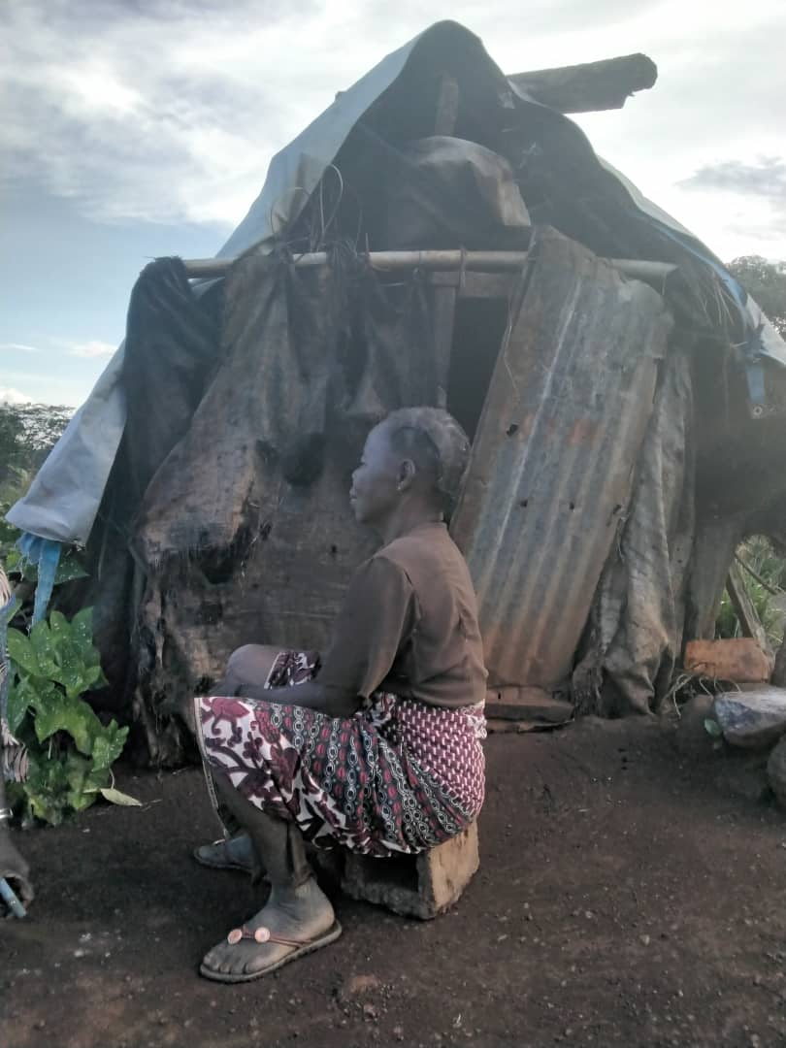
Comparing Internally Displaced Persons with Those Left Behind: Evidence from the Central African Republic
September 20, 2024
Jonathan Lain ⓡ
Gervais Chamberlin Yama ⓡ
Johannes Hoogeveen ⓡ

Slide 2
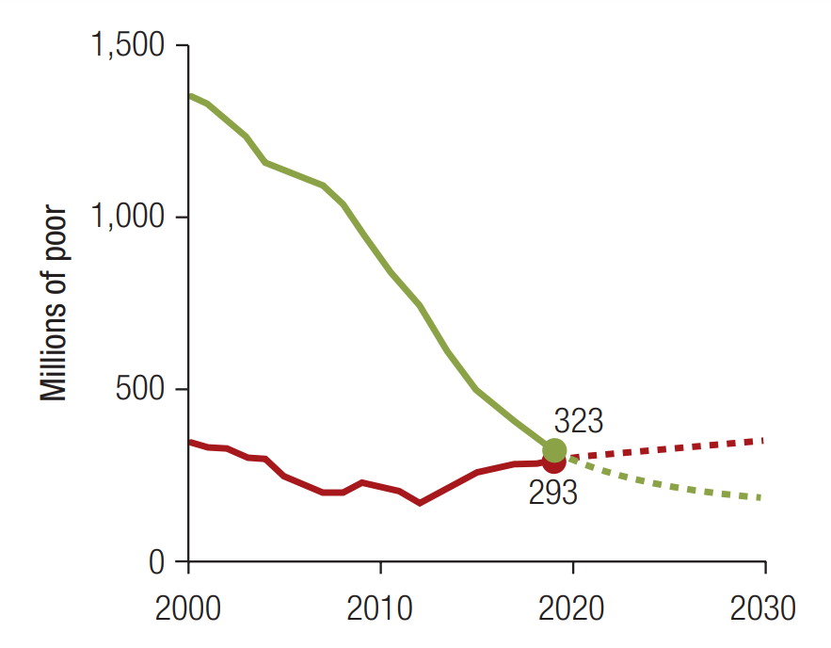
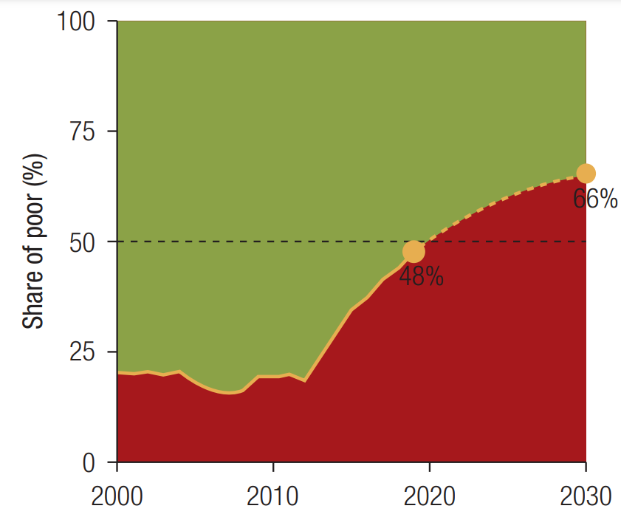


Global poverty is increasingly becoming concentrated in conflict-affected settings
Projected number of global poor
Share of the global poor
Note: FCS = fragile and conflict-affected situation. Source: Adapted from ‘Fragility and Conflict: On the Front Lines of the Fight against Poverty’ (Corral, Irwin, Krishnan, Mahler, and Vishwanath; 2020).

Slide 3
Collecting and analyzing welfare data on internally displaced persons (IDPs) is challenging for several reasons
Sampling and fieldwork logistics are not straightforward. Displaced people are moving or they may live in locations – like camps – missed by traditional surveys, while conflict hampers data collection.
“Standard” questionnaires need to be tailored to reflect the experiences of IDPs. Measures of monetary income or consumption may be distorted if displaced populations rely on humanitarian assistance and do not participate in typical markets for food and non-food items.
IDPs are highly heterogeneous. IDPs’ experiences are different depending on whether they live in camps or other communities, the types of borders they have crossed, or the original cause of displacement.
It is difficult to construct the counterfactual. To estimate the effects of displacement, we need to know what would have happened had IDPs not been displaced…
Notes:
Traditional household surveys risk missing displaced populations because they live in specific locations – like camps – that may not be in traditional sample frames, they are still on the move, they may settle in areas previously unsettled, or because they may be too small in number unless they are explicitly oversampled
Summarizing possible solutions, Eckman and Himelein (2022) outline nine ways to sample IDPs and refugees, ranging from screening respondents in the field and adapting the sampling accordingly to using innovative techniques involving satellite imagery and mobile phone trace data.
Expert Group on Refugee, Internally Displaced Persons, and Statelessness Statistics (EGRISS) also emphasize additional logistical considerations when conducting fieldwork with displaced populations, including assessing the risks associated with entering conflict-affected areas, ensuring enumerators are able to communicate effectively with respondents, and undertaking field visits to assess the viability of potential sampling strategies
Possible to

Slide 4
Constructing suitable counterfactuals presents one specific challenge when trying to assess the welfare effects of forced displacement
Simply comparing displaced people and non-displaced people is potentially useful for policy, but it may be misleading for assessing displacement’s welfare effects because:
The communities from which people are displaced are not a random selection of communities in the country – IDPs come from places affected by conflict and natural disasters.
Within communities, certain households or individuals, may be more likely to move, depending on their assets, education, and existing networks.
Notes:
Highlight the main issue addressed in the paper with a red box

Slide 5
Road map
Data
Methodology
Results
Discussion

Slide 6
The Central African Republic (CAR) has endured a long history of political instability and violence, resulting in forced displacement
Conflict events and fatalities in CAR, 2009-2022
Total number of IDPs in CAR, 2009-2022
Note: “All events” includes battles, explosions/remote violence, protests, riots, strategic developments, and violence against civilians. The chart counts the number of such events that took place each month. “Fatalities” counts the total number of deaths recorded in that month. Source: Armed Conflict Location and Event Data Project (ACLED) and authors’ estimates.
Source: Internal Displacement Monitoring Centre (IDMC) and authors’ estimates.

Slide 7
In 2021, household survey data covering people living in and outside of IDP camps were collected in CAR
Main data source: 2021 Enquête Harmonisée sur le Conditions de Vie des Ménages (EHCVM)
The survey was collected in two waves – April-June 2021 and October-December 2021.
It includes questions on monetary and non-monetary welfare that follow regional standards (through the broader EHCVM initiative) and international best practices.
The sampling strategy integrated those living in IDP camps – this was made possible by close collaboration between the Institut Centrafricain des Statistiques et des Etudes Economiques et Sociales (ICASEES), UNHCR, and the World Bank.
The questionnaire also gathered detailed information on people’s displacement histories.

Slide 8
Road map
Data
Methodology
Results
Discussion

Slide 9
Recap: constructing suitable counterfactuals to assess the welfare effects of forced displacement is difficult
Focus of this paper
Simply comparing displaced people and non-displaced people is potentially useful for policy, but it may be misleading for assessing displacement’s welfare effects because:
The communities from which people are displaced are not a random selection of communities in the country – IDPs come from places affected by conflict and natural disasters.
Within communities, certain households or individuals, may be more likely to move, depending on their assets, education, and existing networks.
Notes:
Highlight the main issue addressed in the paper with a red box

Slide 10
Information on displacement histories can help identify “catchment areas” for IDP camps – the places from which people were displaced
The approach hinges on isolating communities from which people were displaced – “catchment areas” – as these may serve as better counterfactuals.
This involves writing down the top préfectures (Admin 1), sous-préfectures (Admin 2), and communes (Admin 3) of origin for 90 percent of camp dwellers.
The analysis focuses on catchment areas constructed at the sous-prefecture level, to give a large enough sample of catchment area households without watering down the sample with households that are a long way from origin communities.
IDP camps and sous-préfecture-level catchment areas
Source: Humanitarian Data Exchange (for shapefiles), 2021 EHCVM, and author’s calculations.

Slide 11
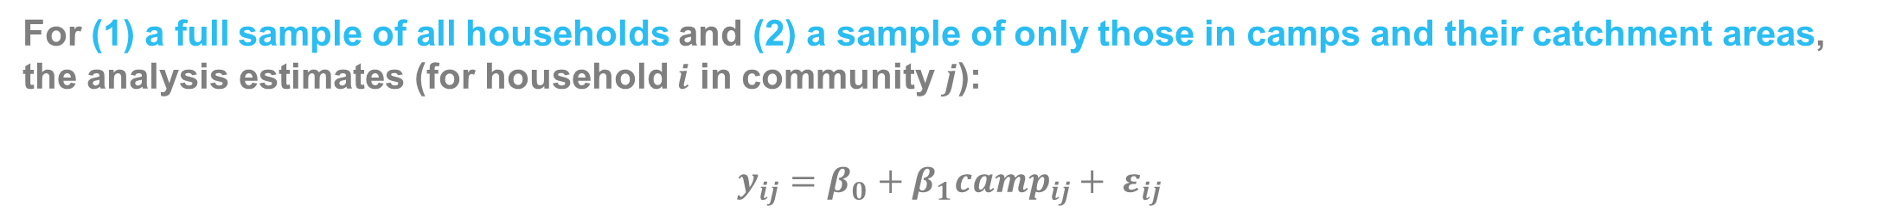
The main results compare those living in camps with (1) the rest of CAR’s population and (2) only those living in catchment areas
For (1) a full sample of all households and (2) a sample of only those in camps and their catchment areas, the analysis estimates (for household $i$ in community $j$):
$$y_{ij}=β_{0}+β_{1}{camp}_{ij}+ ε_{ij}$$
Dummy variable for whether the household is in an official IDP camp
Outcome variables, including:
Log of deflated per capita consumption (with and without gifted consumption)
Monetary poverty
Food security (poor or borderline Food Consumption Score (FCS))
Non-monetary poverty (education and basic infrastructure)

Slide 12
The analysis does not directly address household- or individual-level selection, as doing so reliably is not possible with the 2021 EHCVM data
Potential household- and individual-level controls that would typically be stable – such as household size, household head, and dwelling characteristics – could be affected by displacement.
Comparison of household characteristics between camps and sous-préfecture-level catchment areas
 | Catchment area (mean) |  | Camp (mean) |  | Difference
Overall household size | 5.349 | (2.807) | 5.003 | (2.492) | -0.346 | (0.152)
Number of dependents | 3.001 | (2.137) | 2.914 | (2.129) | -0.087 | (0.620)
Household head is male | 0.789 | (0.408) | 0.701 | (0.458) | -0.088*** | (0.005)
Household head age | 41.114 | (12.403) | 39.539 | (11.746) | -1.576** | (0.046)
Household head has primary education | 0.589 | (0.492) | 0.548 | (0.498) | -0.041 | (0.464)
Household head is working | 0.914 | (0.281) | 0.874 | (0.332) | -0.040 | (0.259)
Household head works outside of agriculture | 0.219 | (0.414) | 0.323 | (0.468) | 0.103** | (0.032)
Adequate material for walls | 0.977 | (0.149) | 0.402 | (0.490) | -0.575*** | (0.000)
Adequate material for roof | 0.284 | (0.451) | 0.033 | (0.179) | -0.251*** | (0.000)
Adequate material for floor | 0.128 | (0.334) | 0.007 | (0.083) | -0.121*** | (0.000)
Observations | 883 |  | 495 |  | 1,378
Imperfect robustness check: control for some plausibly stable subset of household-level variables in the main regressions – makes little difference to the main results.
Note: * p<0.10, ** p<0.05, *** p<0.01. p-values in parentheses. Standard errors clustered at the enumeration area level. Individual-level weights applied for all variables except household size and number of dependents. Source: 2021 EHCVM and authors’ calculations.

Slide 13
Road map
Data
Methodology
Results
Discussion

Slide 14
Monetary consumption is lower in camps than the rest of CAR, but this difference disappears when comparing camps to their catchment areas
Comparison of household characteristics between camps and sous-préfecture-level catchment areas
The magnitude of the difference between in camp and out-of-camp households drops nearly tenfold and is no longer statistically significant when restricting the out-of-camp sample to catchment areas only.
Removing gifted consumption does not qualitatively affect the results.
 | Compared to all out-of-camp households | Compared to sous-préfecture catchment area
In camp (1=Y;0=N) | -0.2369*** | -0.0267
 | (0.0029) | (0.7786)
N | 6411 | 1378
R-squared | 0.0043 | 0.0003
Note: * p<0.10, ** p<0.05, *** p<0.01. p-values in parentheses. Dependent variable: Log of real per capita consumption. Standard errors clustered at the enumeration area level. Source: 2021 EHCVM and authors’ calculations.

Slide 15
The reduced difference between in-camp and out-of-camp households appears across the full consumption distribution
Comparing the full consumption distribution for in-camp and out-of-camp households
Panel A: Compared to all out-of-camp households
Panel B: Compared to out-of-camp households from camp catchment areas
Note: Epanechnikov kernel density function used. Bandwidth set to 0.3. Source: 2021 EHCVM and authors’ calculations.

Slide 16
Monetary poverty is higher in camps than the whole of the rest of CAR, but the difference disappears when comparing to catchment areas
Comparing monetary poverty for in-camp and out-of-camp households
The difference for overall poverty and food poverty becomes much smaller and is no longer statistically significant when comparing in-camp households to those in camp catchment areas rather than the full population.
Similar results emerge for food security, measured using the FCS.
Note: * p<0.10, ** p<0.05, *** p<0.01. p-values in parentheses. Standard errors clustered at the enumeration area level. Individual-level weights applied for all variables except household size and number of dependents. Source: 2021 EHCVM and authors’ calculations.

Slide 17
For non-monetary poverty, access to improved water is more prevalent in camps; this gap widens when comparing to catchment areas
Comparing non-monetary poverty for in-camp and out-of-camp households
Deprivation indicator (1=deprived, 0=not deprived) | Compared to all out-of-camp households | Compared to sous-préfecture catchment area
Educational enrolment | 0.0513 | -0.0055
 | (0.3191) | (0.9252)
Educational attainment | 0.0825* | 0.0073
 | (0.0806) | (0.8967)
Water | -0.1407*** | -0.2372***
 | (0.0041) | (0.0003)
Sanitation | -0.0303 | -0.0413
 | (0.6749) | (0.5973)
Electricity | 0.1068*** | 0.0583***
 | (0.0000) | (0.0076)
Note: * p<0.10, ** p<0.05, *** p<0.01. p-values in parentheses. Coefficients for different dependent variables shown in each row. Standard errors clustered at the enumeration area level. Sample sizes and R-squared values not reported for parsimony. Source: 2021 EHCVM and authors’ calculations.

Slide 18
Road map
Data
Methodology
Results
Discussion

Slide 19
Going forward, policy and data collection should be adapted to consider not only IDPs but also people who are left behind
Main message: poverty-reducing interventions should consider communities from where displaced people originate too; they may be even harder to reach with key services (like water and sanitation).
Data collection also needs to be adapted to consider those left behind. This could include:
Two-step sampling, where IDPs are interviewed first to find out from where they were displaced.
Using longitudinal data to track people before, during, and after displacement.
Collecting recalled data on households’ pre-displacement characteristics (although this comes with challenges).

Slide 20
Annex

Slide 21
Using alternative geographical levels to construct catchment areas
Préfecture
Commune
Source: Humanitarian Data Exchange (for shapefiles), 2021 EHCVM, and author’s calculations.
Source: Humanitarian Data Exchange (for shapefiles), 2021 EHCVM, and author’s calculations.

Slide 22
List of prefectures, sous-prefectures, and communes used as catchment areas
Préfecture |  | Sous-préfecture |  | Commune
Code | Name | Code | Name | Code | Name
32 | Ouham | 326 | Bantangafo | 3261 | Batangafo
42 | Nana-Grebizi | 327 | Kabo | 3264 | Ouassi
43 | Ouaka | 421 | Kaga-Bandoro | 3265 | Bakassa
52 | Haute-Kotto | 431 | Bambari | 3272 | Ouaki
62 | Mbomou | 434 | Kouango | 4211 | Kaga-Bandoro
61 | Basse-Kotto | 435 | Ippy | 4212 | Botto
 |  | 521 | Bria | 4213 | Nana-Outa
 |  | 612 | Alindao | 4311 | Bambari
 |  | 621 | Bangassou | 4312 | Danga-Gboudou
 |  | 712 | 2ème arrondissement | 4314 | Pladama-Ouaka
 |  |  |  | 4321 | Koudou-Bego
 |  |  |  | 4331 | Grimari
 |  |  |  | 4343 | Cochio-Toulou
 |  |  |  | 4351 | Ippy
 |  |  |  | 4352 | Yengou
 |  |  |  | 5211 | Samba-Boungou
 |  |  |  | 5311 | Ridina
 |  |  |  | 6121 | Alindao
 |  |  |  | 6211 | Bangassou
 |  |  |  | 6241 | Rafai
 |  |  |  | 7121 | 2ème arrondissement
Source: 2021 EHCVM and authors’ calculations.

Slide 23
Monetary consumption results: gifted consumption removed
Regression comparing in-camp and out-of-camp households in terms of the log of real per capita consumption, removing gifts
 | Compared to all out-of-camp households | Compared to sous-préfecture catchment area
In camp (1=Y;0=N) | -0.3652*** | -0.1360
 | (0.0000) | (0.1596)
N | 6411 | 1378
R-squared | 0.0099 | 0.0060
Note: * p<0.10, ** p<0.05, *** p<0.01. p-values in parentheses. Dependent variable: Log of real per capita consumption. Standard errors clustered at the enumeration area level. Source: 2021 EHCVM and authors’ calculations.

Slide 24
Monetary consumption results: different geographical levels used to construct catchment areas
Regression comparing in-camp and out-of-camp households in terms of the log of real per capita consumption, with all catchment area levels
 | Compared to all out-of-camp households | Compared to préfecture catchment area | Compared to sous-préfecture catchment area | Compared to commune catchment area
In camp (1=Y;0=N) | -0.2369*** | 0.0167 | -0.0267 | -0.0883
 | (0.0029) | (0.8427) | (0.7786) | (0.4152)
N | 6411 | 2307 | 1378 | 1151
R-squared | 0.0043 | 0.0001 | 0.0003 | 0.0027
Note: * p<0.10, ** p<0.05, *** p<0.01. p-values in parentheses. Dependent variable: Log of real per capita consumption. Standard errors clustered at the enumeration area level. Source: 2021 EHCVM and authors’ calculations.

Slide 25
Monetary consumption results: adding controls
Regression comparing in-camp and out-of-camp households in terms of the log of real per capita consumption, including household-level controls
 | Compared to all out-of-camp households |  | Compared to sous-préfecture catchment area
 | No controls | With controls | No controls | With controls
In camp (1=Y;0=N) | -0.2369*** | -0.1686** | -0.0267 | -0.0091
 | (0.0029) | (0.0441) | (0.7786) | (0.9229)
N | 6411 | 6411 | 1378 | 1378
R-squared | 0.0043 | 0.1753 | 0.0003 | 0.1625
Note: * p<0.10, ** p<0.05, *** p<0.01. p-values in parentheses. Dependent variable: Log of real per capita consumption. Controls include household size, number of dependents, and the sex, age, and education of the household head. Standard errors clustered at the enumeration area level. Source: 2021 EHCVM and authors’ calculations.

